Slide 1
Cleanipedia – Hindustan Unilever
Team Brogrammers

Slide 2
Module 1 : Integrated Performance Dashboard

Slide 3
Problem Statement
Current Scenario :
HUL has different modes of communicating with the user using social media. Every social media platform provides its own analytics. In Cleanipedia we aim to provide a single dashboard for all social media platforms.
Proposed Solution :
To create a single platform using AWS and analytics API of social media platforms to help in the analysis of performance of running campaigns and company’s user base demographics.
Platform we have covered?
Twitter
Youtube

Slide 4
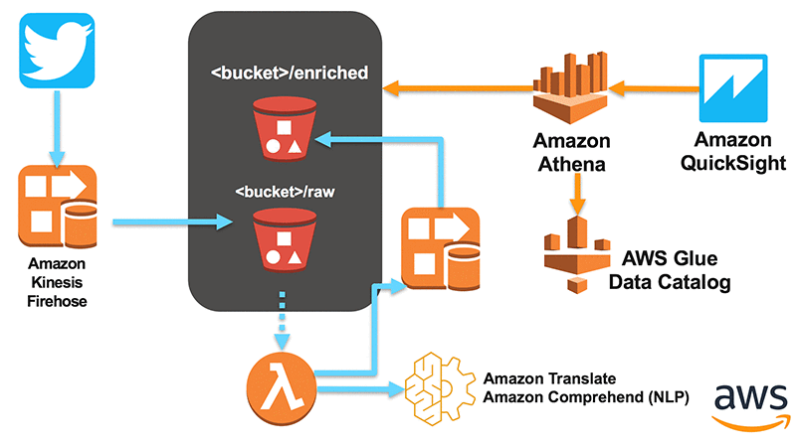
Twitter

Slide 5
Youtube
Given youtube video URL, corresponding metadata is extracted.
Using PAFY library we have taken out the features like - video duration, view count, number of likes, rating etc.

Slide 6
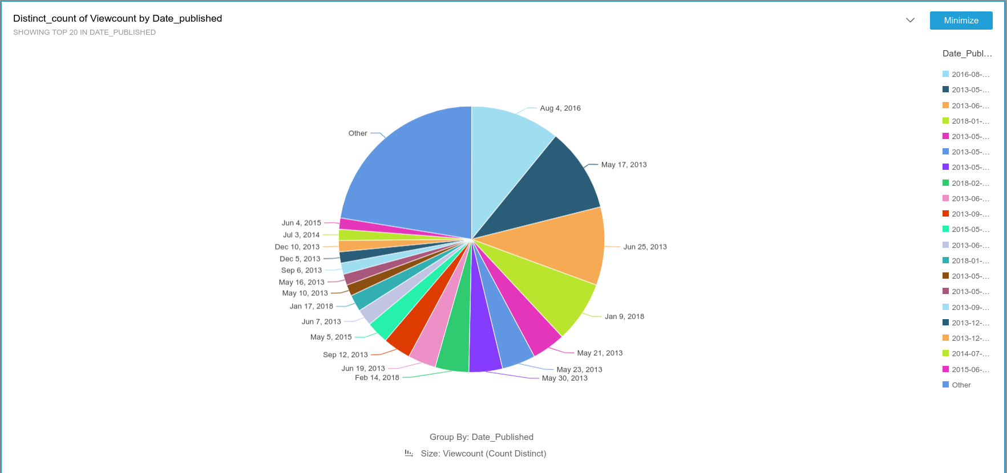

Slide 7
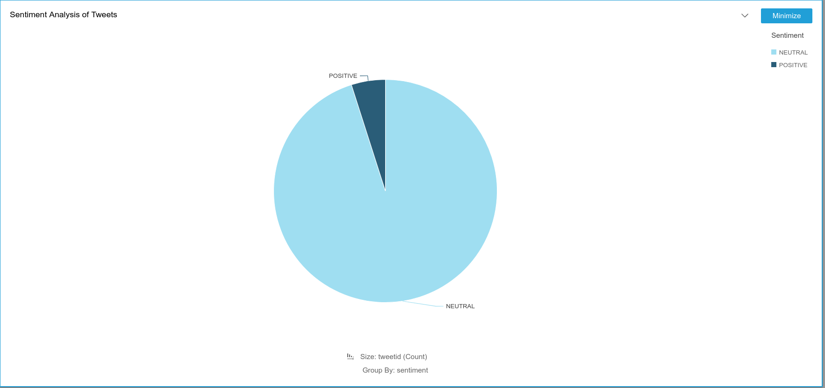

Slide 8
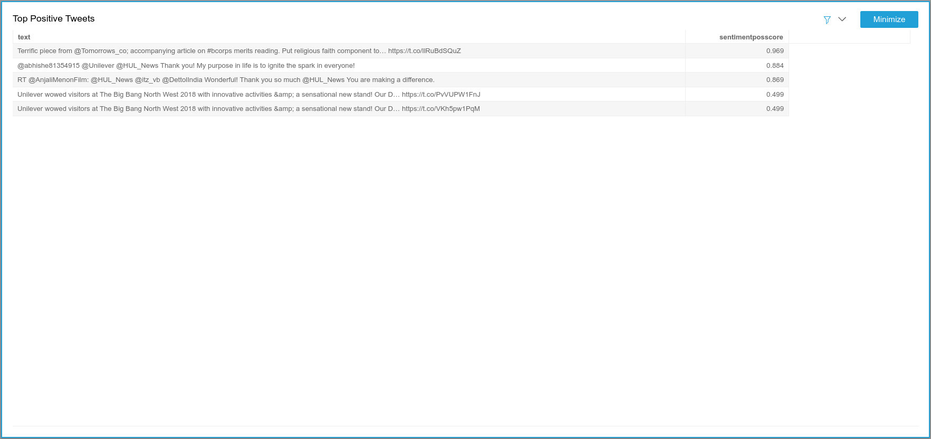

Slide 9


Slide 10
Module 2 : Consumer Engagement

Slide 11
Problem Statement
Current Scenario :
HUL has several articles on it’s website talking about the products they sell. How can we make use of them in cleanipedia and increase customer engagement.
Proposed Solution :
Let us come up with a discussion forum which will be powered up by a Recommendation Engine to come up with articles that are user-centric and slowly propel the prospects to be our customers.
Recommendations based on what?
Based on what user reads (content of the article)
Based on what others read with similar reading habits
Based on user’s personal and demographic data

Slide 12
Content Based Filtering
Using LDA and TF-IDF with NER Models

Slide 13
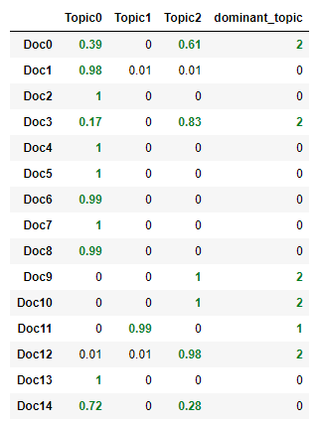
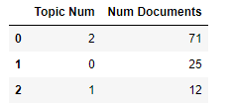
LDA (Latent Dirichlet Allocation)
Corpus of Articles
Tokenization and Stemming
Vectorization of data
LDA Model training
Grid Search

Slide 14
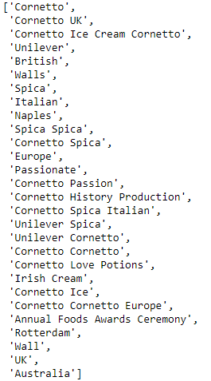
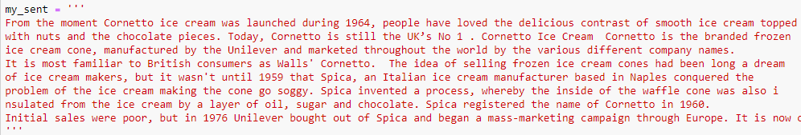
NER (Named Entity Recognition)
Article X
Tokenization and Stemming
Chunking
Parse the chunked tree
Named Entities

Slide 15
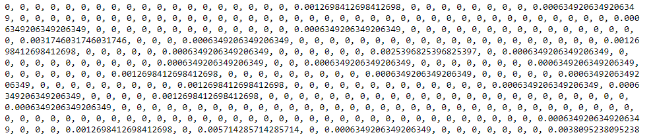
TF-IDF (Term Frequency – Inverse Document Frequency)
Given a pair of documents, it tries to find the similarity between them.
Let us consider a term “product”
Cosine Similarity
Term Frequency
Inverse Document Frequency
Vector representation of article

Slide 16
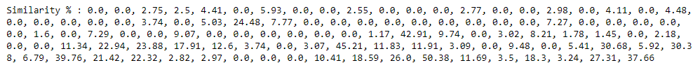
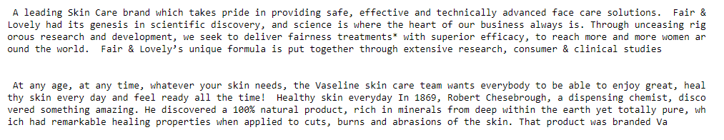
Working

Slide 17
Collaborative Filtering
Using Spectral and K-prototypes Clustering

Slide 18
Spectral Clustering
Article Read-History of users
Spectral Clustering Model
Clusters of user profiles
Recommendation made
Find the trending article in user’s cluster

Slide 19
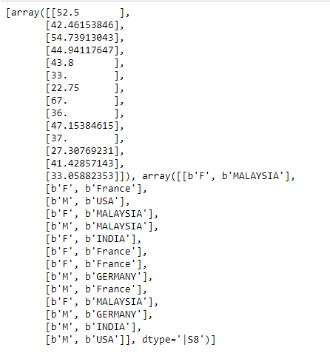
K-prototypes Clustering
User’s Personal and Demographic data
Data Pre-processing
Finding ideal value of K
K-protypes Clustering Model
Rules
Keywords Generation
Identify user’s cluster
Pickled LDA Model
Recommendation Generated

Slide 20


Architecture of Recommendation System
User Identifier
FLASK REST SERVER HOSTED ON CLOUD
Articles
LDA Model
Spectral Clustering
User Profiles
Rules
Reading Habits
TF-IDF with NER Model
K-prototypes Clustering
Pickled Models

Slide 21
Module 3 : Integration with Ecommerce Link

Slide 22
Problem Statement
Current Scenario :
The HUL products are scattered across the web and it becomes difficult for the users to go to different merchant websites and search for the same.
Proposed Solution :
Use of Google Custom Search Engine
Benefits :
One Stop Solution
Saves Customer Time
Increases sale of the product

Slide 23
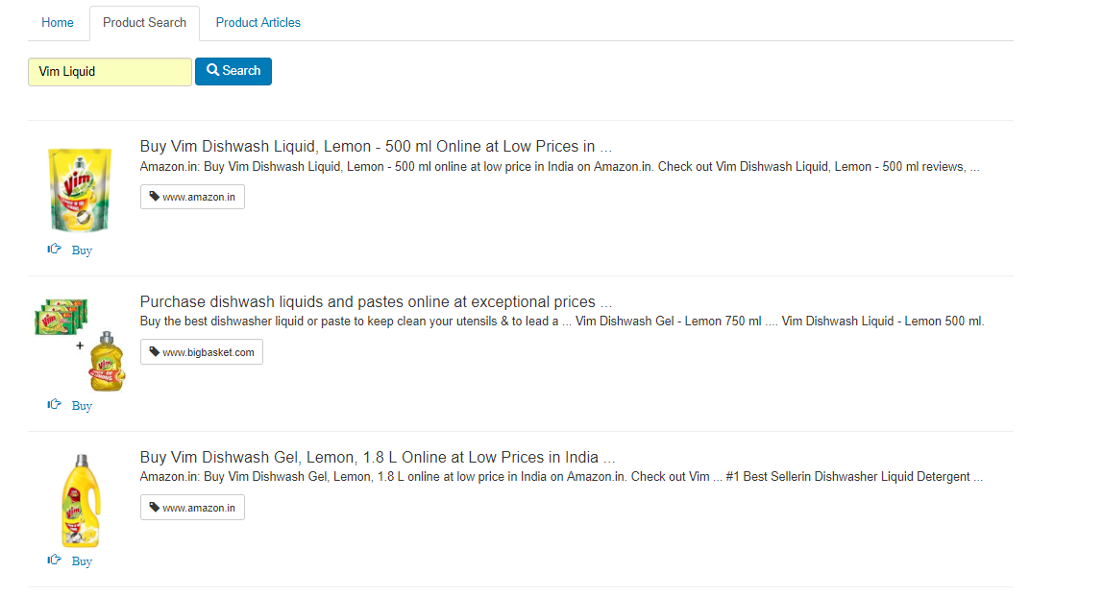
Architecture
Google Custom Search Engine
Custom Search API
hindustanunilever.herokuapp.com
[REST Server - NodeJS]
Formatted JSON Response

